Slide 1
NVL Mobile System config, BOM Proposal for best optimal design
Client Customer Engineering
WW17

Slide 2
Summary
Goal:
Best system config and BOM for best quality, best battery life and performance with NVL
Product scope:
NVL-HX/H based mobile design in Premium and Mainstream
Proposal
Great outcome of BOM risk assessment and proliferation in PTL, showing less PCBA BOM, components related issue → continue in NVL.
Intel will share set of best optimal system config [new], BOM for best quality, battery life and performance
OEM/ODM are recommended to follow the system config/BOM as foundation
OEM/ODM may change to other config/BOM only if there are differentiated and end user perceivable features

Slide 3
Foundational System config and BOM selection principal
RVP config/BOM
AEP/GS config &BOM
Select the best optimal out of RVP, AEP/GS and Best-in-class PTL OxM design practices – what we believe the great foundation for NVL
MSFT 2026 HDE requirement should be included but pending latest HDE requirement
Best in class PTL design practices learning
( best battery life, best performance, MSFT hero design best modern standby)

Slide 4
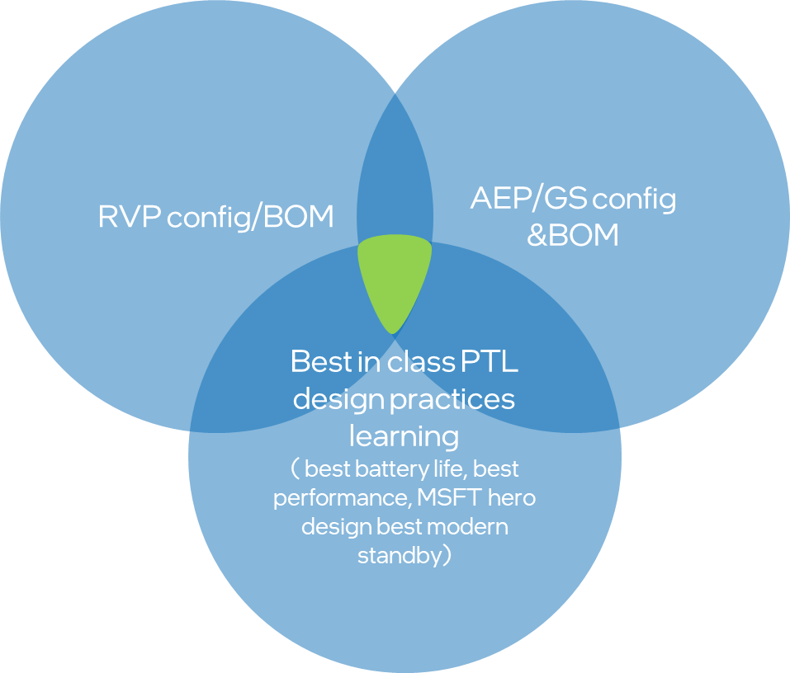
Intel and customer partner on OEM’s unique features, innovation as product differentiator
OEM’s unique product differentiator and focus areas, innovation
Foundational System Config and BOM
Highly recommend customer to follow 100% to achieve foundation

Slide 5
Proposal
System BOM, PCBA, key components which impact quality, battery, performance
HPD
EC
IMVP
Camera
PD
SSD
Memory
Retimer/redriver
Display

Slide 6
Best System BOM, PCBA, key components proposal which impact quality, battery, performance
Need each ingredient team to help define GBB (Good, Better, Best) based on SPP, segmentation.
Component | NVL-HX RVP/AEP | HP Mancala | Result | Note
DRAM | Micron E1 module, | Memory enabling guide #858687
 | MPN: MTD8C10324N2FN023F1
IMVP9.3 VR Controller | MPS MP29020GQNT, RT RTQ3700, Renesas | MPS MP29021GQKT
EC | Microchip MEC1723 | NUVOTON_NPCX499HA1BX (HP co-use with PTL designs)
Display | EDP1.4/1.5 with PSR support panel | EDP1.4/1.5 with PSR support panel
WLAN/BT | Whale Peak 2, spider Peak2, Lizard Peak | Whale Peak 2
HPD solution | TRADE-OFF: USB camera lower power in MODS, but higher SOC power in active scenarios. MIPI camera lower power in active scenarios (Teams) | PCL #870781
Camera | WF/UF RGB – 13MP 2D Camera OV13B Omnivision, RGB-IR: Legacy from previous project OV01A1S Omnivision, UF IR Camera OG0VA1B Omnivision, DPHY RGB 8M Low power camera OV08X40 Omnivision, UF Camera USB2 KBDD741 V2, UF Camera eUSB2 5.2 MP OV05C10(KAFD913) Omnivision, CPHY Camera (UF and WF) 14.5MP IMX688 Sony, AON Controller – Synaptics SVP7500 Synaptics, | PCL #870781
Audio Codec / AMP | RTK AIOC Gen6 SNDW ACX ALC712-VB, RTK SNDW ACX ALC722-CG RTK AIOC Gen6 SNDW ACX ALC713-VB, Cirrus AIC v3 SNDW ACX Cohen (CS42L43), TI AIOC Gen1 SNDW ACX TAC5682 AMP: RTK AIOC Gen6 ALC1320, RTK AIOC Gen6 ALC1320, Cirrus AIC v3 Jamerson (CS35L56), TI AIOC Gen12 TAS2880 (Stereo) | REALTEK_ALC3335_CGT (HP Mancala currently use)
BIOS Flash | 64MB SPI Flash with RPMC 1.8V @100MHz (Single flash topology) 1.Winbond W25R512NWEIQ 2.Macrinix MX77U51250F | WINBOND_W25Q256JWEIN

Slide 7
Best System BOM, PCBA, key components proposal which impact quality, battery, performance
Need each ingredient team to help define GBB (Good, Better, Best) based on SPP, segmentation.
Component | NVL-HX RVP/AEP | HP Mancala | Result | Note
HDMI redriver | Parade PS8219QFN46ITR-B0 | ANALOGIX_ANX7494Q46
HDMI retimer | Parade PS8419QFN46GTR-A1 | Mancala does not use HDMI retimer
TBT Retimer / Discrete TBT | June Bridge / Barlow Ridge | Hyden Bridge (HP co-use with PTL designs)
PD Controller | TI: PTPS669982BAZBJT (win OS POR) Realtek: RTS5452P-20E-GR, Realtek: RTS5453P- 20E-GR | TI:TPS66994BAREPR
USB3.2 Gen2 Redriver | Diode J41453-002 | Mancala does not use USB3.2 Gen2 redriver
eUSB2 Repeater | TI: TUSBE111BC1(WCSP/QFN) NXP: PTN3222GM (QFN), PTL3222DUK (WLCSP12 with auto resume) Diodes: PI3EUSB1181 (QFN) RTK: RTS5430S-GR (QFN) --> not validated on RVP Analogix: ANX7461 (QFN) → not validated on RVP | Discreet single:: Diodes PI3EUSB1181 Discreet dual: TI PTUSB2E2211001VBWR
Charger | Renesas ISL95522AHRZ | RENESAS_RAA489110AS07GNP
LAN IC (mostly for corp only) | Jacksonville | Jacksonville (Gbe)
 | Foxville (not recommend as challenge to meet E*)

